Slide 1

Japan Shrine & Temple Navigator:
Personalized Guidance with GPT & Interactive Maps
2025/08/08
Advisor：Yi-Chung Chen
Members： Po-Yuan Chu, Bo-Min Zheng

Slide 2

Progress
Chat Mode
Map Mode
Conclusion
Future Work
This Week's Progress
Intelligent Chat Mode:
Expanded "Quick Explore" options and added a "City-Specific Filter".
Enabled context-aware queries and AI-powered personalized responses based on time and location.
Enhanced Map Mode:
Implemented filters for "Attractions" and "Shrines & Temples".
Developed interactive pop-ups and a structured details panel for points of interest.
Notes:
我來總結一下本週的進度。在聊天模式中，我們的體驗變得更加智慧。
Let's summarize this week's progress. In Chat Mode, we've made the experience much smarter.
我們將『Quick Explore』選項從四個擴增到八個，並加入了城市篩選器。 這讓 AI 能根據使用者選擇的地點和當前時間，生成個人化、具備情境感知的回覆。
We expanded the 'Quick Explore' options from four to eight and introduced a city filter. This allows the AI to generate personalized, context-aware responses based on both the user's selected location and the current time.
在地圖模式中，我們新增了之前規劃的景點和神社篩選器。 使用者現在可以點擊任何地標，來獲得快速的摘要彈窗，然後進一步查看結構化的詳細資訊面板，其中甚至包含了可以查看更多評論的 QR Code。
In Map Mode, we've added the promised filters for attractions and shrines. Users can now click on any point of interest to get a quick pop-up summary, and then access a detailed, structured information panel, which even includes a QR code for more reviews.

Slide 3
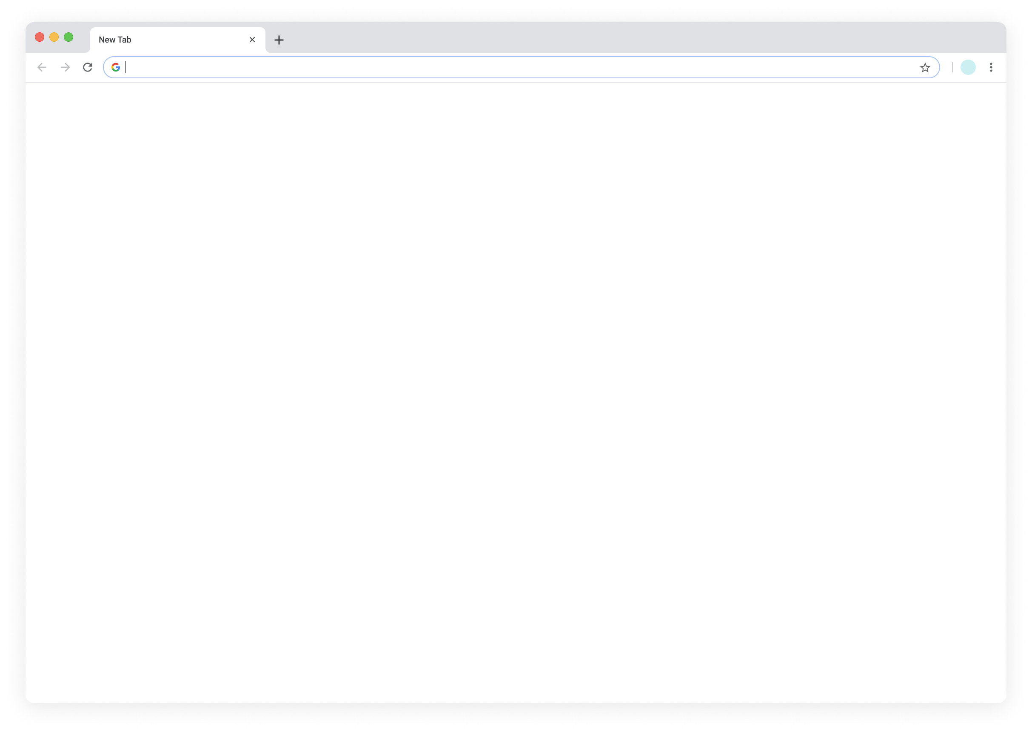
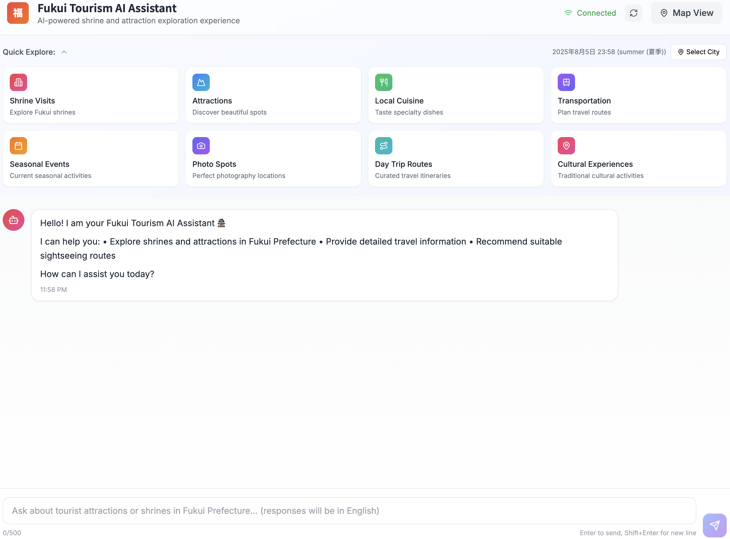
Progress
Chat Mode
Map Mode
Conclusion
Future Work
User Interface – Chat Mode
Enhanced "Quick Explore" Feature
The number of quick-access categories has been expanded from “four to eight”,
offering users more diverse and direct options to enhance their exploration experience.
Notes:
首先，我們來看一下在聊天模式 (Chat Mode) 的進度。我們著重在優化使用者介面，第一個更新是『Quick Explore』這個功能。
First, let's look at our recent progress in the Chat Mode. We've focused on enhancing the user interface, starting with the 'Quick Explore' feature.
我們將快捷按鈕從原本的四個擴充到了八個 。這為使用者提供了更多元的直接選項，例如『季節性活動』和『拍照景點』，讓他們從一開始就能更方便地找到想要的資訊。
We have expanded the number of quick-access buttons from four to eight. This provides users with a wider range of direct options, like 'Seasonal Events' and 'Photo Spots', making it easier for them to find what they're looking for right away.

Slide 4
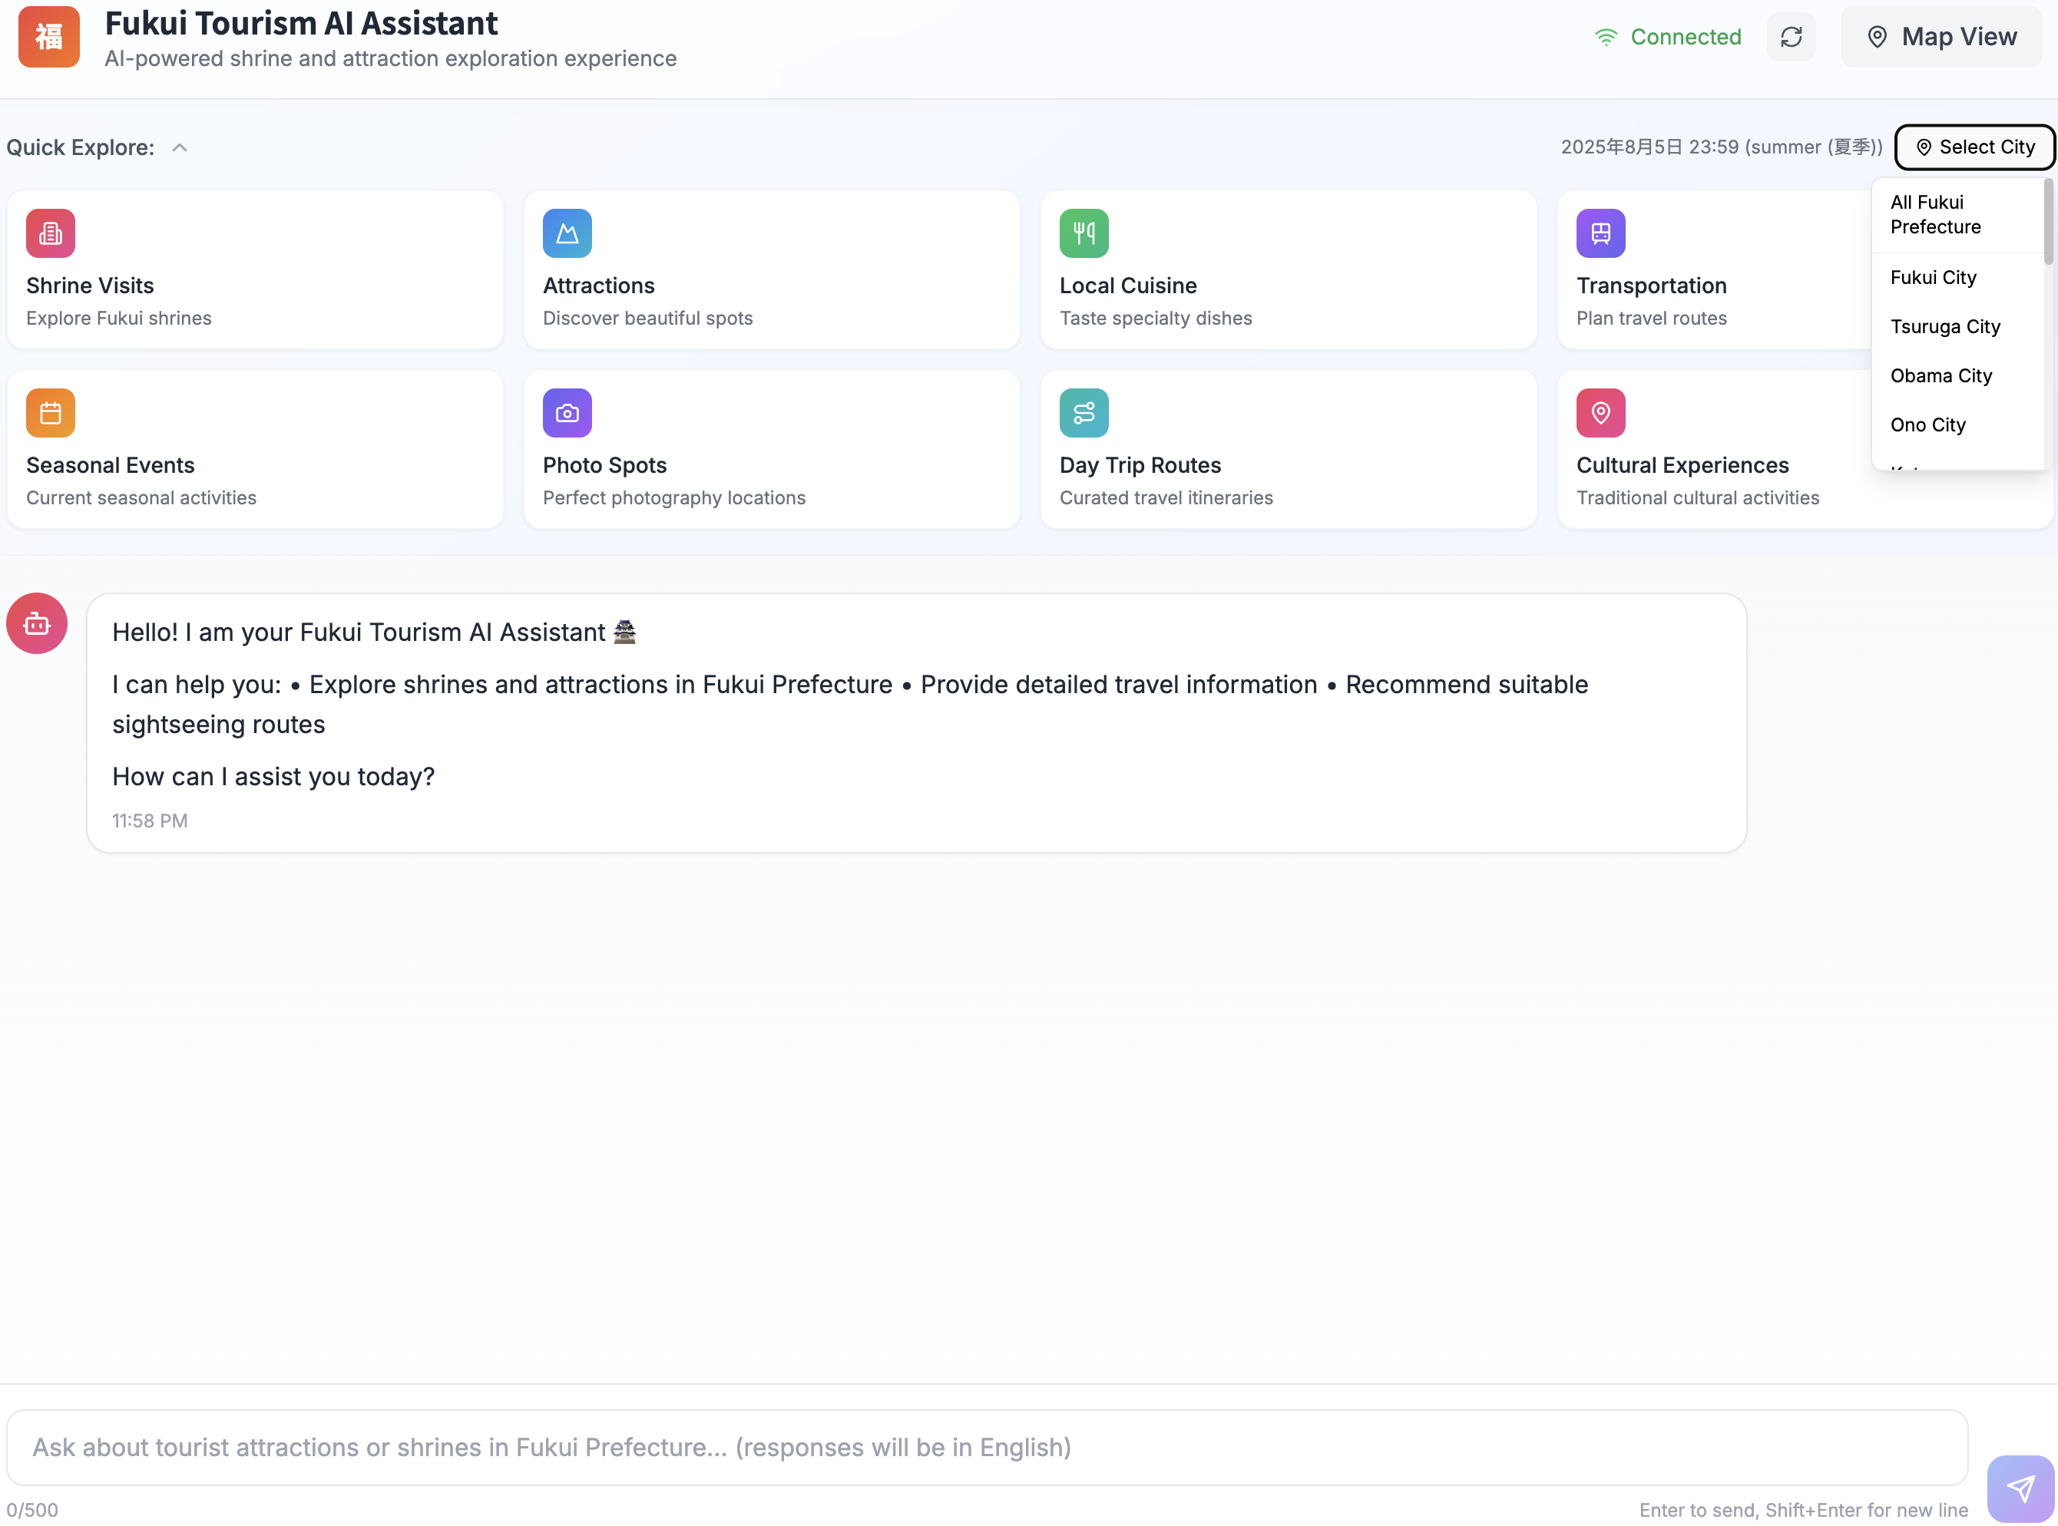
Progress
Chat Mode
Map Mode
Conclusion
Future Work
User Interface – Chat Mode
City-Specific Filtering
A "Select City" feature has been added, enabling users to filter information and receive recommendations tailored to a specific city within Fukui Prefecture.
Notes:
為了讓資訊更貼近使用者需求，我們也導入了城市選擇功能。大家可以在右上角看到這個按鈕。
To make the information more relevant, we've also introduced a city selection feature. You can see it at the top right corner.
這個功能讓使用者可以很方便地針對特定地區，例如福井市或敦賀市，來篩選他們想問的問題。這能確保我們提供的推薦和搜尋結果，都精準地符合他們感興趣的地點。
This allows users to easily filter their queries by a specific area, such as Fukui City or Tsuruga City. This ensures that the recommendations and search results are precisely tailored to the location they are interested in.

Slide 5
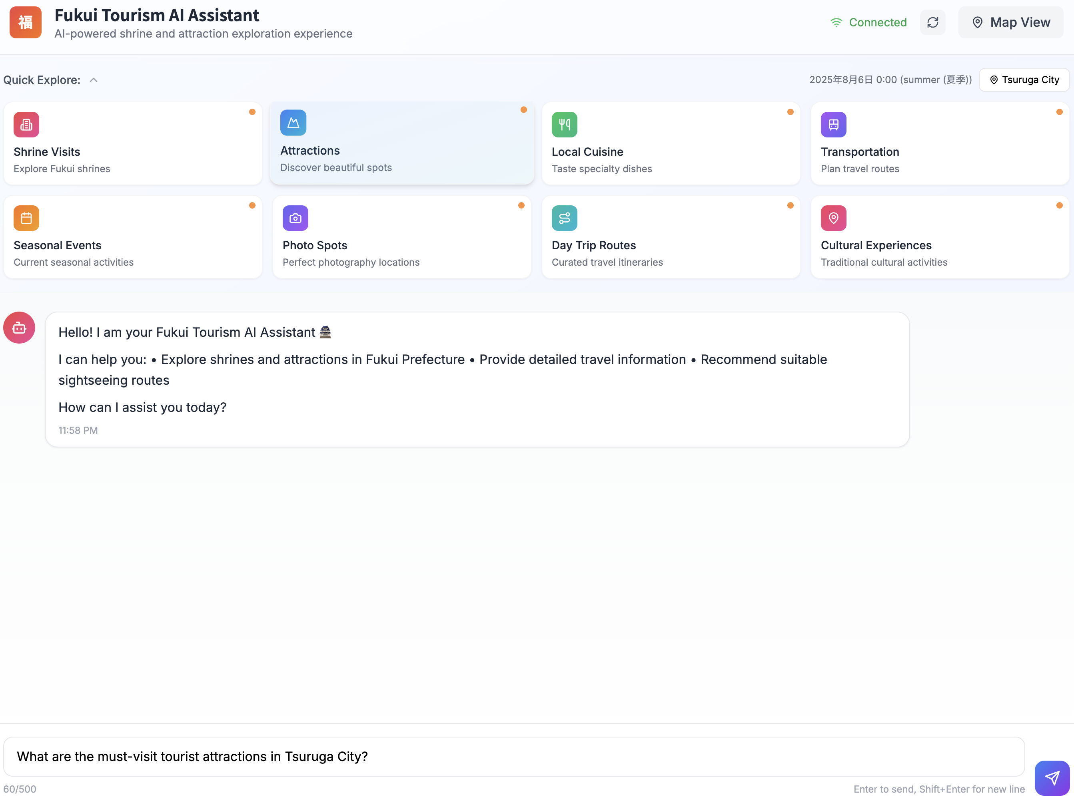
Progress
Chat Mode
Map Mode
Conclusion
Future Work
User Interface – Chat Mode
1
City Filter
2
Quick Explore for “Attraction”
By combining the "City Filter" with a "Quick Explore" category, the system automatically generates a specific query and populates it in the chat box, significantly streamlining the user's workflow.
3
Generates a specific query
Notes:
接著說明我們如何簡化使用者的操作流程。首先，使用者選擇一個地點，例如敦賀市。
Here's how we streamline the process for the user. First, the user selects a location, for example, Tsuruga City.
從『Quick Explore』中點擊一個感興趣的類別，就像簡報上顯示的『Attractions (景點)』。
Next, they click a category from 'Quick Explore,' such as 'Attractions' as shown on the slide.
我們的系統就會自動結合這兩項選擇，生成一個可以直接傳送的問題，像是『敦賀市必訪的旅遊景點有哪些？』。這完全省去了打字的麻煩，讓互動變得更快速。
Our system then automatically combines these choices to generate a ready-to-send question like, 'What are the must-visit tourist attractions in Tsuruga City?'. This completely removes the need for typing and makes the interaction much faster.

Slide 6
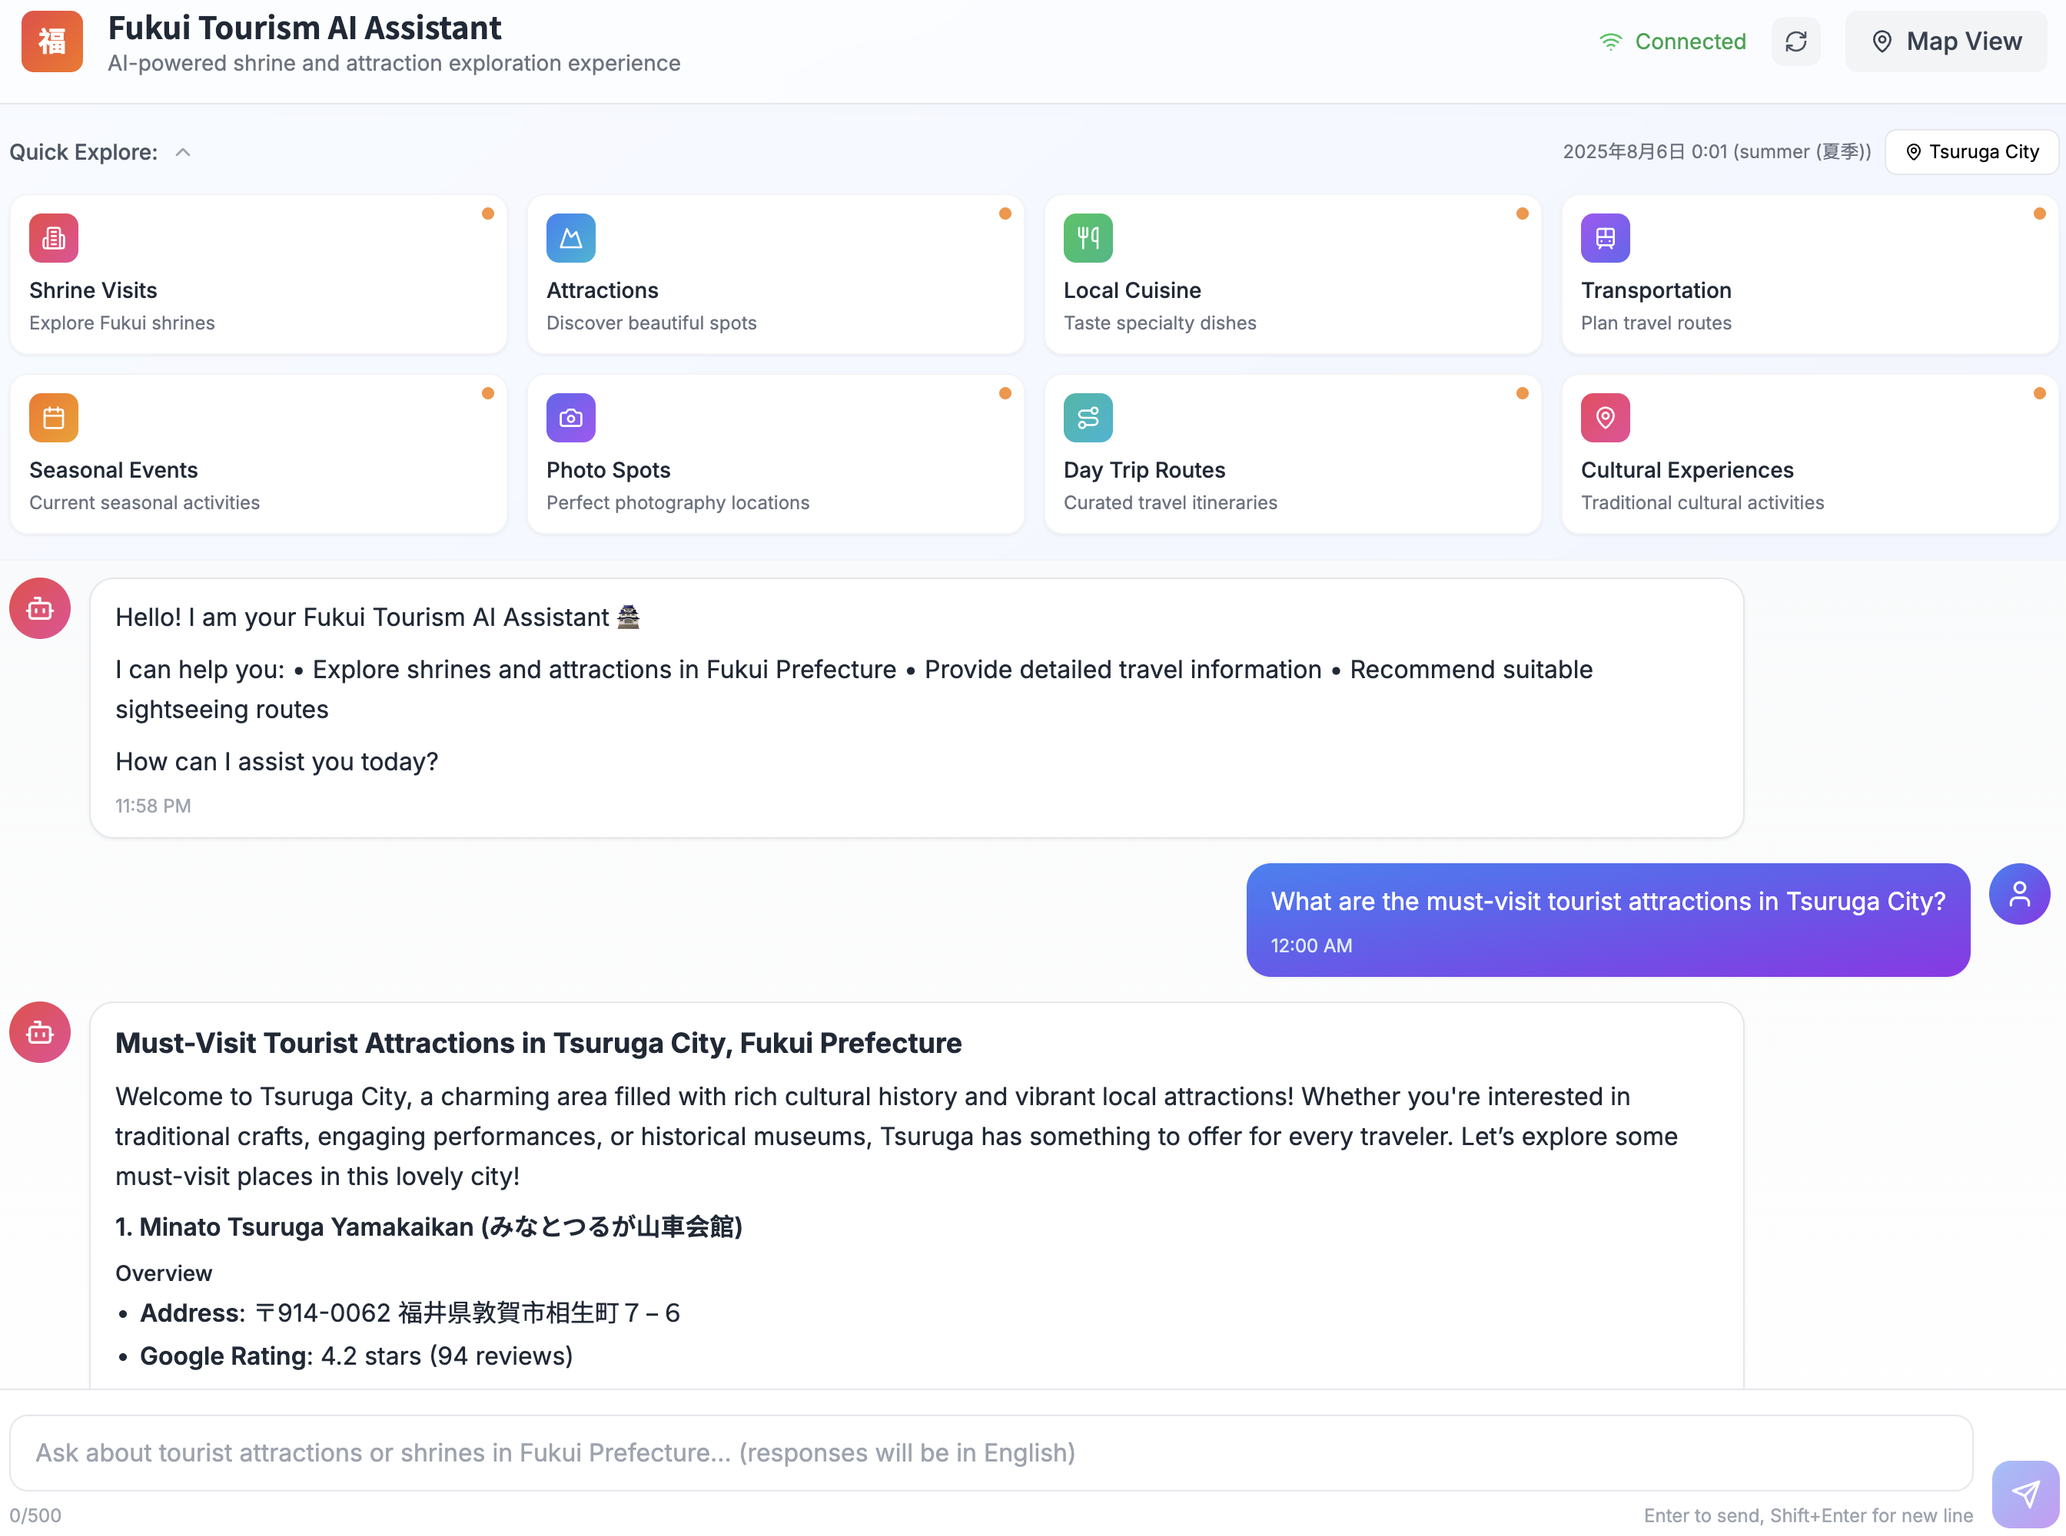
Progress
Chat Mode
Map Mode
Conclusion
Future Work
User Interface – Chat Mode
AI-Powered & Personalized Responses
The system instantly processes the user's query, generating detailed and personalized travel information based on the specified location and topic.
Notes:
當使用者送出問題後，我們的 AI 會提供即時且個人化的回覆。它能理解特定的情境——
Once the user sends the query, our AI provides an instant and personalized response. It understands the specific context
在這個例子中，就是『敦賀市的景點』——並生成詳盡的答案。
in this case, 'attractions in Tsuruga City'—and generates a detailed answer.

Slide 7
Progress
Chat Mode
Map Mode
Conclusion
Future Work
User Interface – Chat Mode
Context-Aware Responses (Time & Location)
Incorporates both the user's selected "location" and the current "time".
2025年8月6日 0:01 (summer(夏季))
AI-Powered & Personalized Responses
The system instantly processes the user's query, generating detailed and personalized travel information based on the specified location and topic.
Notes:
為了讓我們的 AI 更有幫助，我們加入了『情境感知』功能。
To make our AI even more helpful, we've added context awareness.
如同大家所見，系統不僅知道使用者設定的『敦賀市』這個地點，它同時也會考量當下的時間與季節。
The system doesn't just know the location, like 'Tsuruga City,' but it also considers the current time and season, as you can see here.

Slide 8
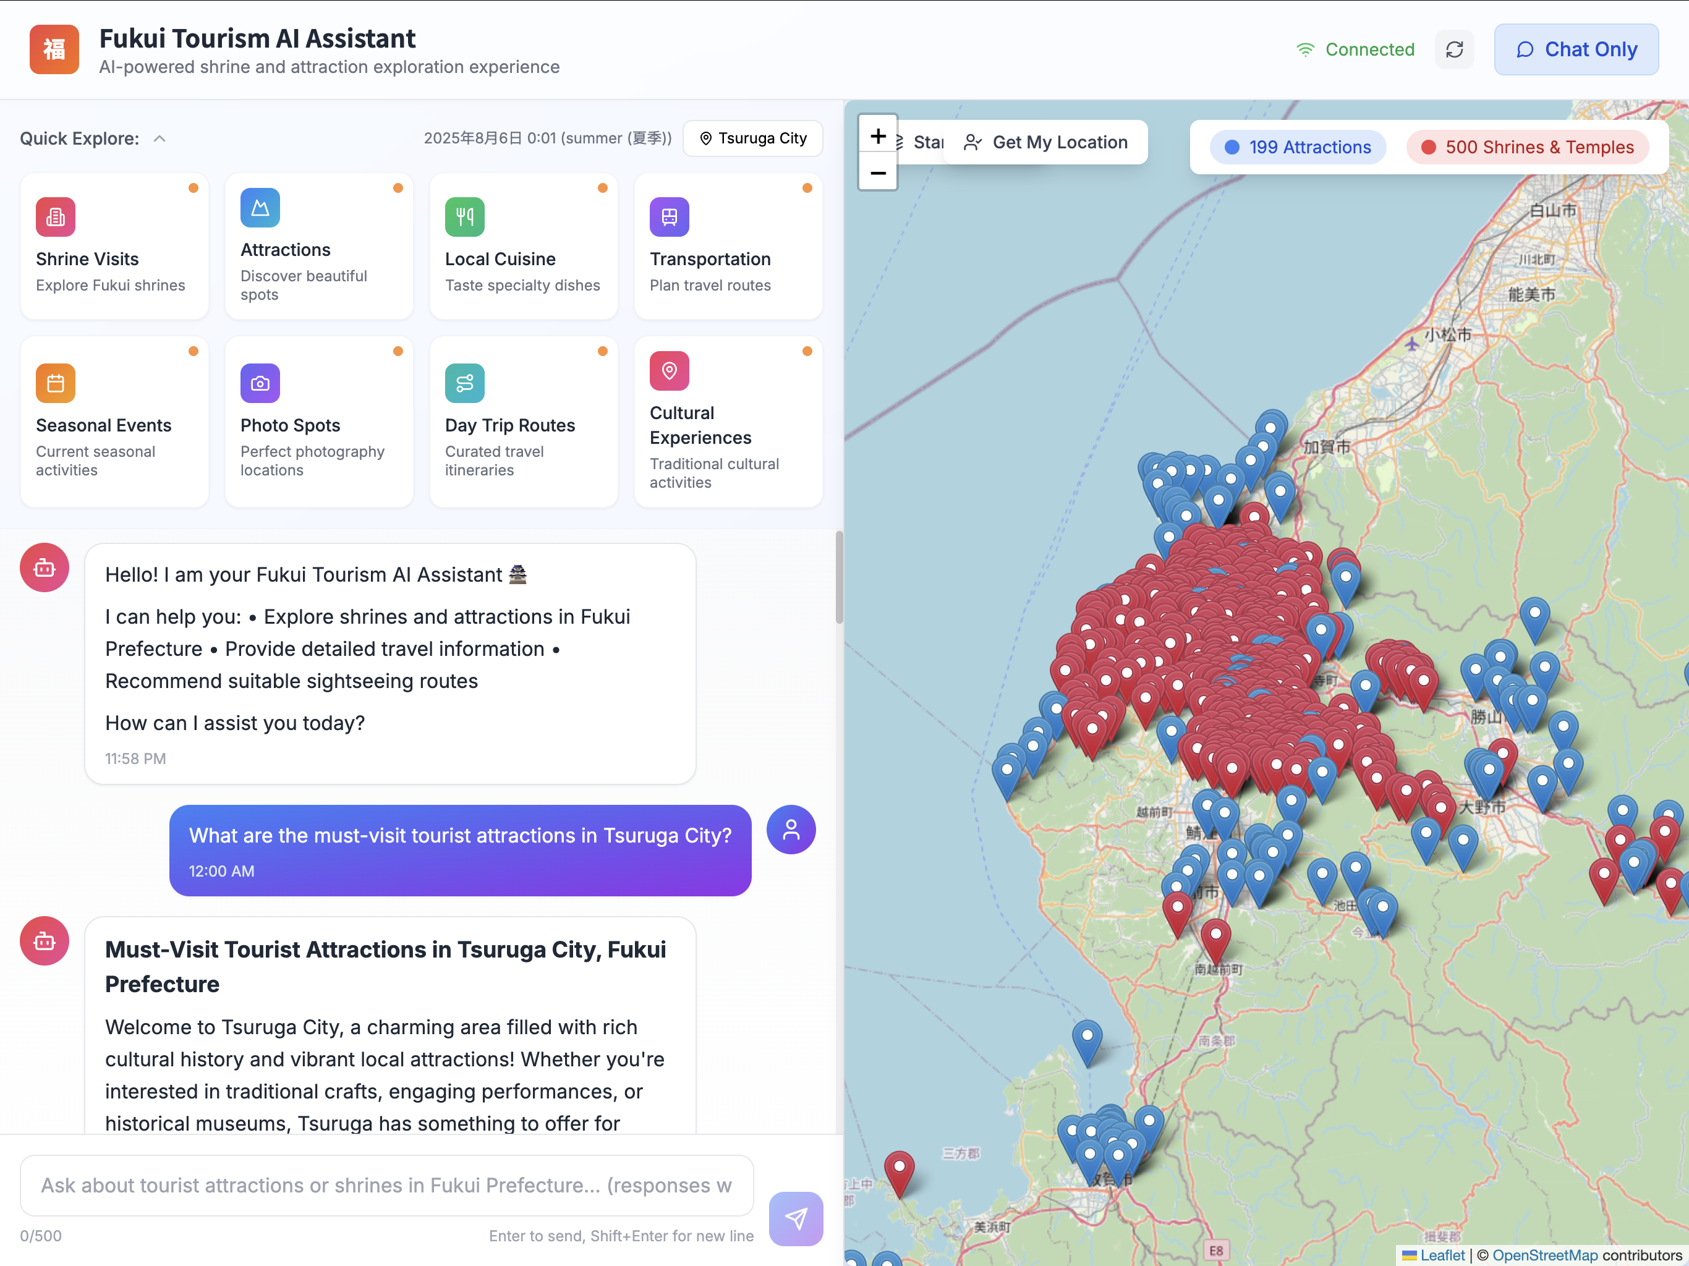
Progress
Chat Mode
Map Mode
Conclusion
Future Work
User Interface – Map Mode
Attraction & Shrine Filters
As a continuation of our previous development goals, we have successfully added filters for "Attractions" and "Shrines & Temples" to the Map Mode interface.
Notes:
好的，現在我們來看看『地圖模式』的進度。
Okay, now let's move on to the 'Map Mode’.
如同我們上次更新所規劃的，我們現在導入了一項關鍵功能：地點篩選器。
As we planned in our last update, we have now introduced a key feature: location filters.
大家可以在地圖上看到，使用者現在可以透過『景點』和『神社』的按鈕，來篩選顯示的圖釘。這能幫助他們整理地圖畫面，只專注在他們想去的地點類型。
As you can see on the map, users can now use the 'Attractions' and 'Shrines & Temples' buttons to filter the pins shown. This helps them to declutter the map and focus only on the type of places they want to visit.

Slide 9

Progress
Chat Mode
Map Mode
Conclusion
Future Work
User Interface – Map Mode
Filter out the map information for the Shrine
Attraction & Shrine Filters
As a continuation of our previous development goals, we have successfully added filters for "Attractions" and "Shrines & Temples" to the Map Mode interface.
Notes:
舉例來說，當我們按下神社的按鈕，就能把神社的地圖資訊過濾掉。
For example, when we click the Shrine button, we can filter out the map information for the Shrine.

Slide 10
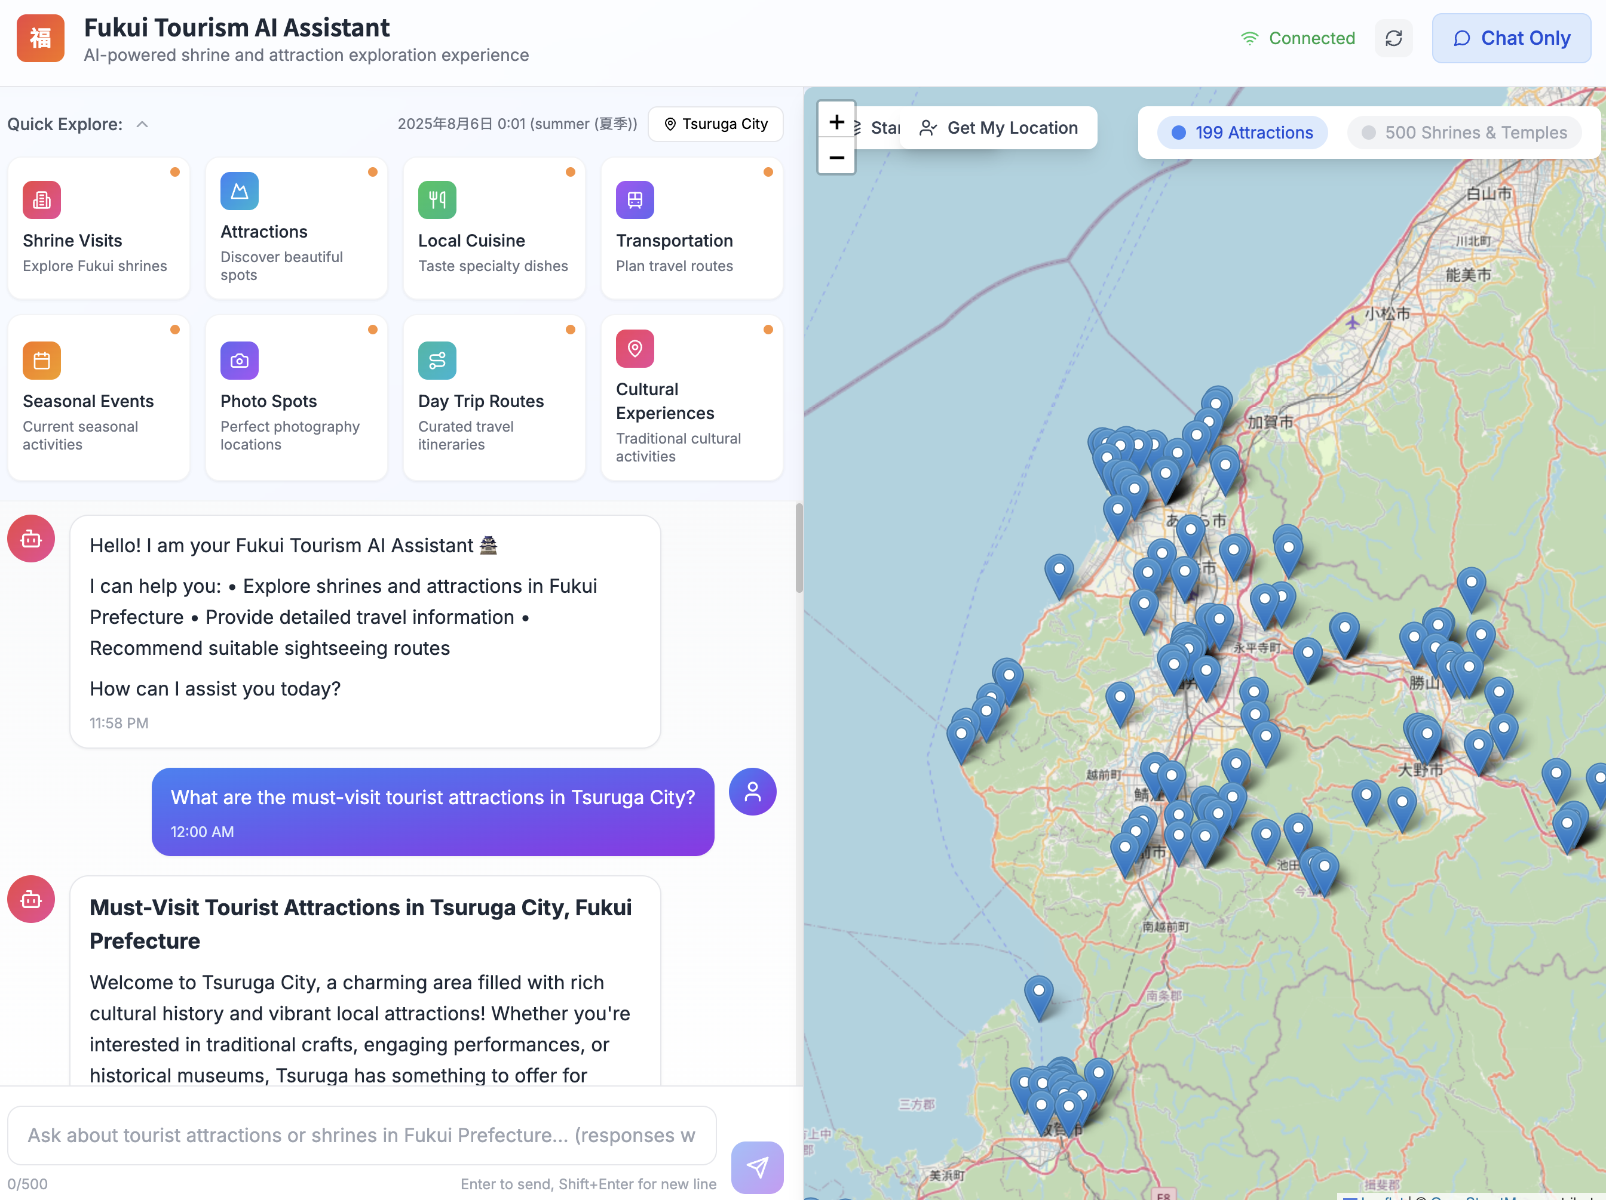
Progress
Chat Mode
Map Mode
Conclusion
Future Work
User Interface – Map Mode
Filter out the map information for the Shrine
Attraction & Shrine Filters
As a continuation of our previous development goals, we have successfully added filters for "Attractions" and "Shrines & Temples" to the Map Mode interface.

Slide 11
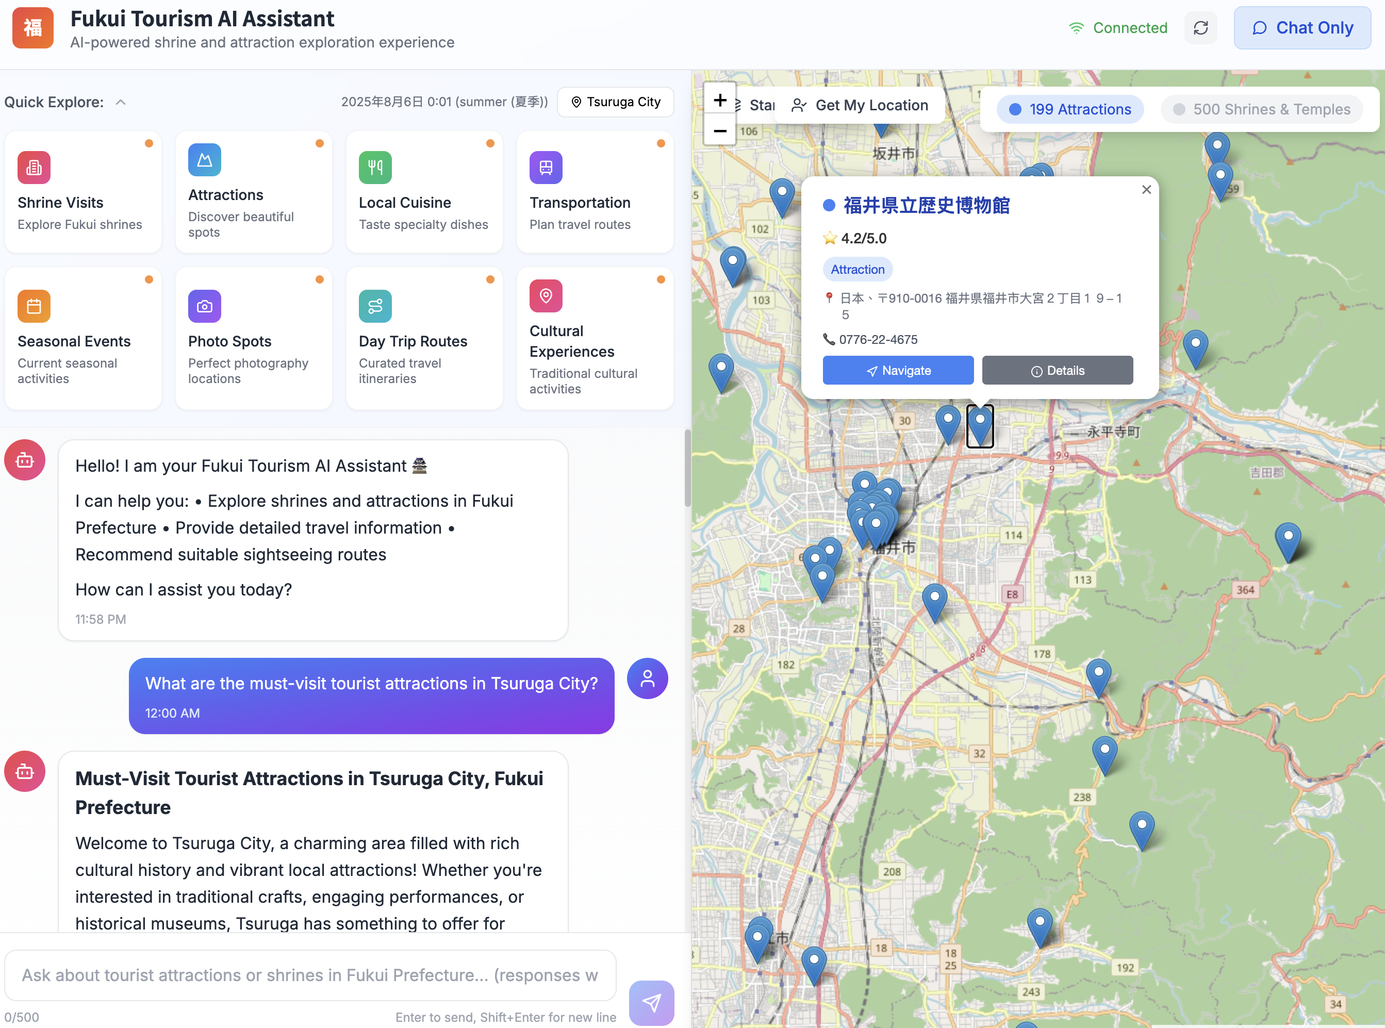
Progress
Chat Mode
Map Mode
Conclusion
Future Work
User Interface – Map Mode
Interactive Point-of-Interest Pop-ups
Clicking a location pin on the map instantly displays a summary pop-up and, users can then select "Details" to view more comprehensive information.
Notes:
現在介紹地圖的互動功能。當使用者點擊任何一個圖釘時，就會出現一個小的彈出視窗，上面有關鍵的摘要資訊。
Now, for the interactive part of the map. When a user clicks on any pin, a small pop-up appears with key summary information. This includes the location's name, its rating, and the address.

Slide 12
Progress
Chat Mode
Map Mode
Conclusion
Future Work
User Interface – Map Mode
Interactive Point-of-Interest Pop-ups
Clicking a location pin on the map instantly displays a summary pop-up and, users can then select "Details" to view more comprehensive information.
Notes:
如果他們想知道更多，只需要點擊『Details』按鈕，就可以看到更深入的資訊。
If they want to learn more, they can simply click the 'Details' button to see an in-depth view.

Slide 13
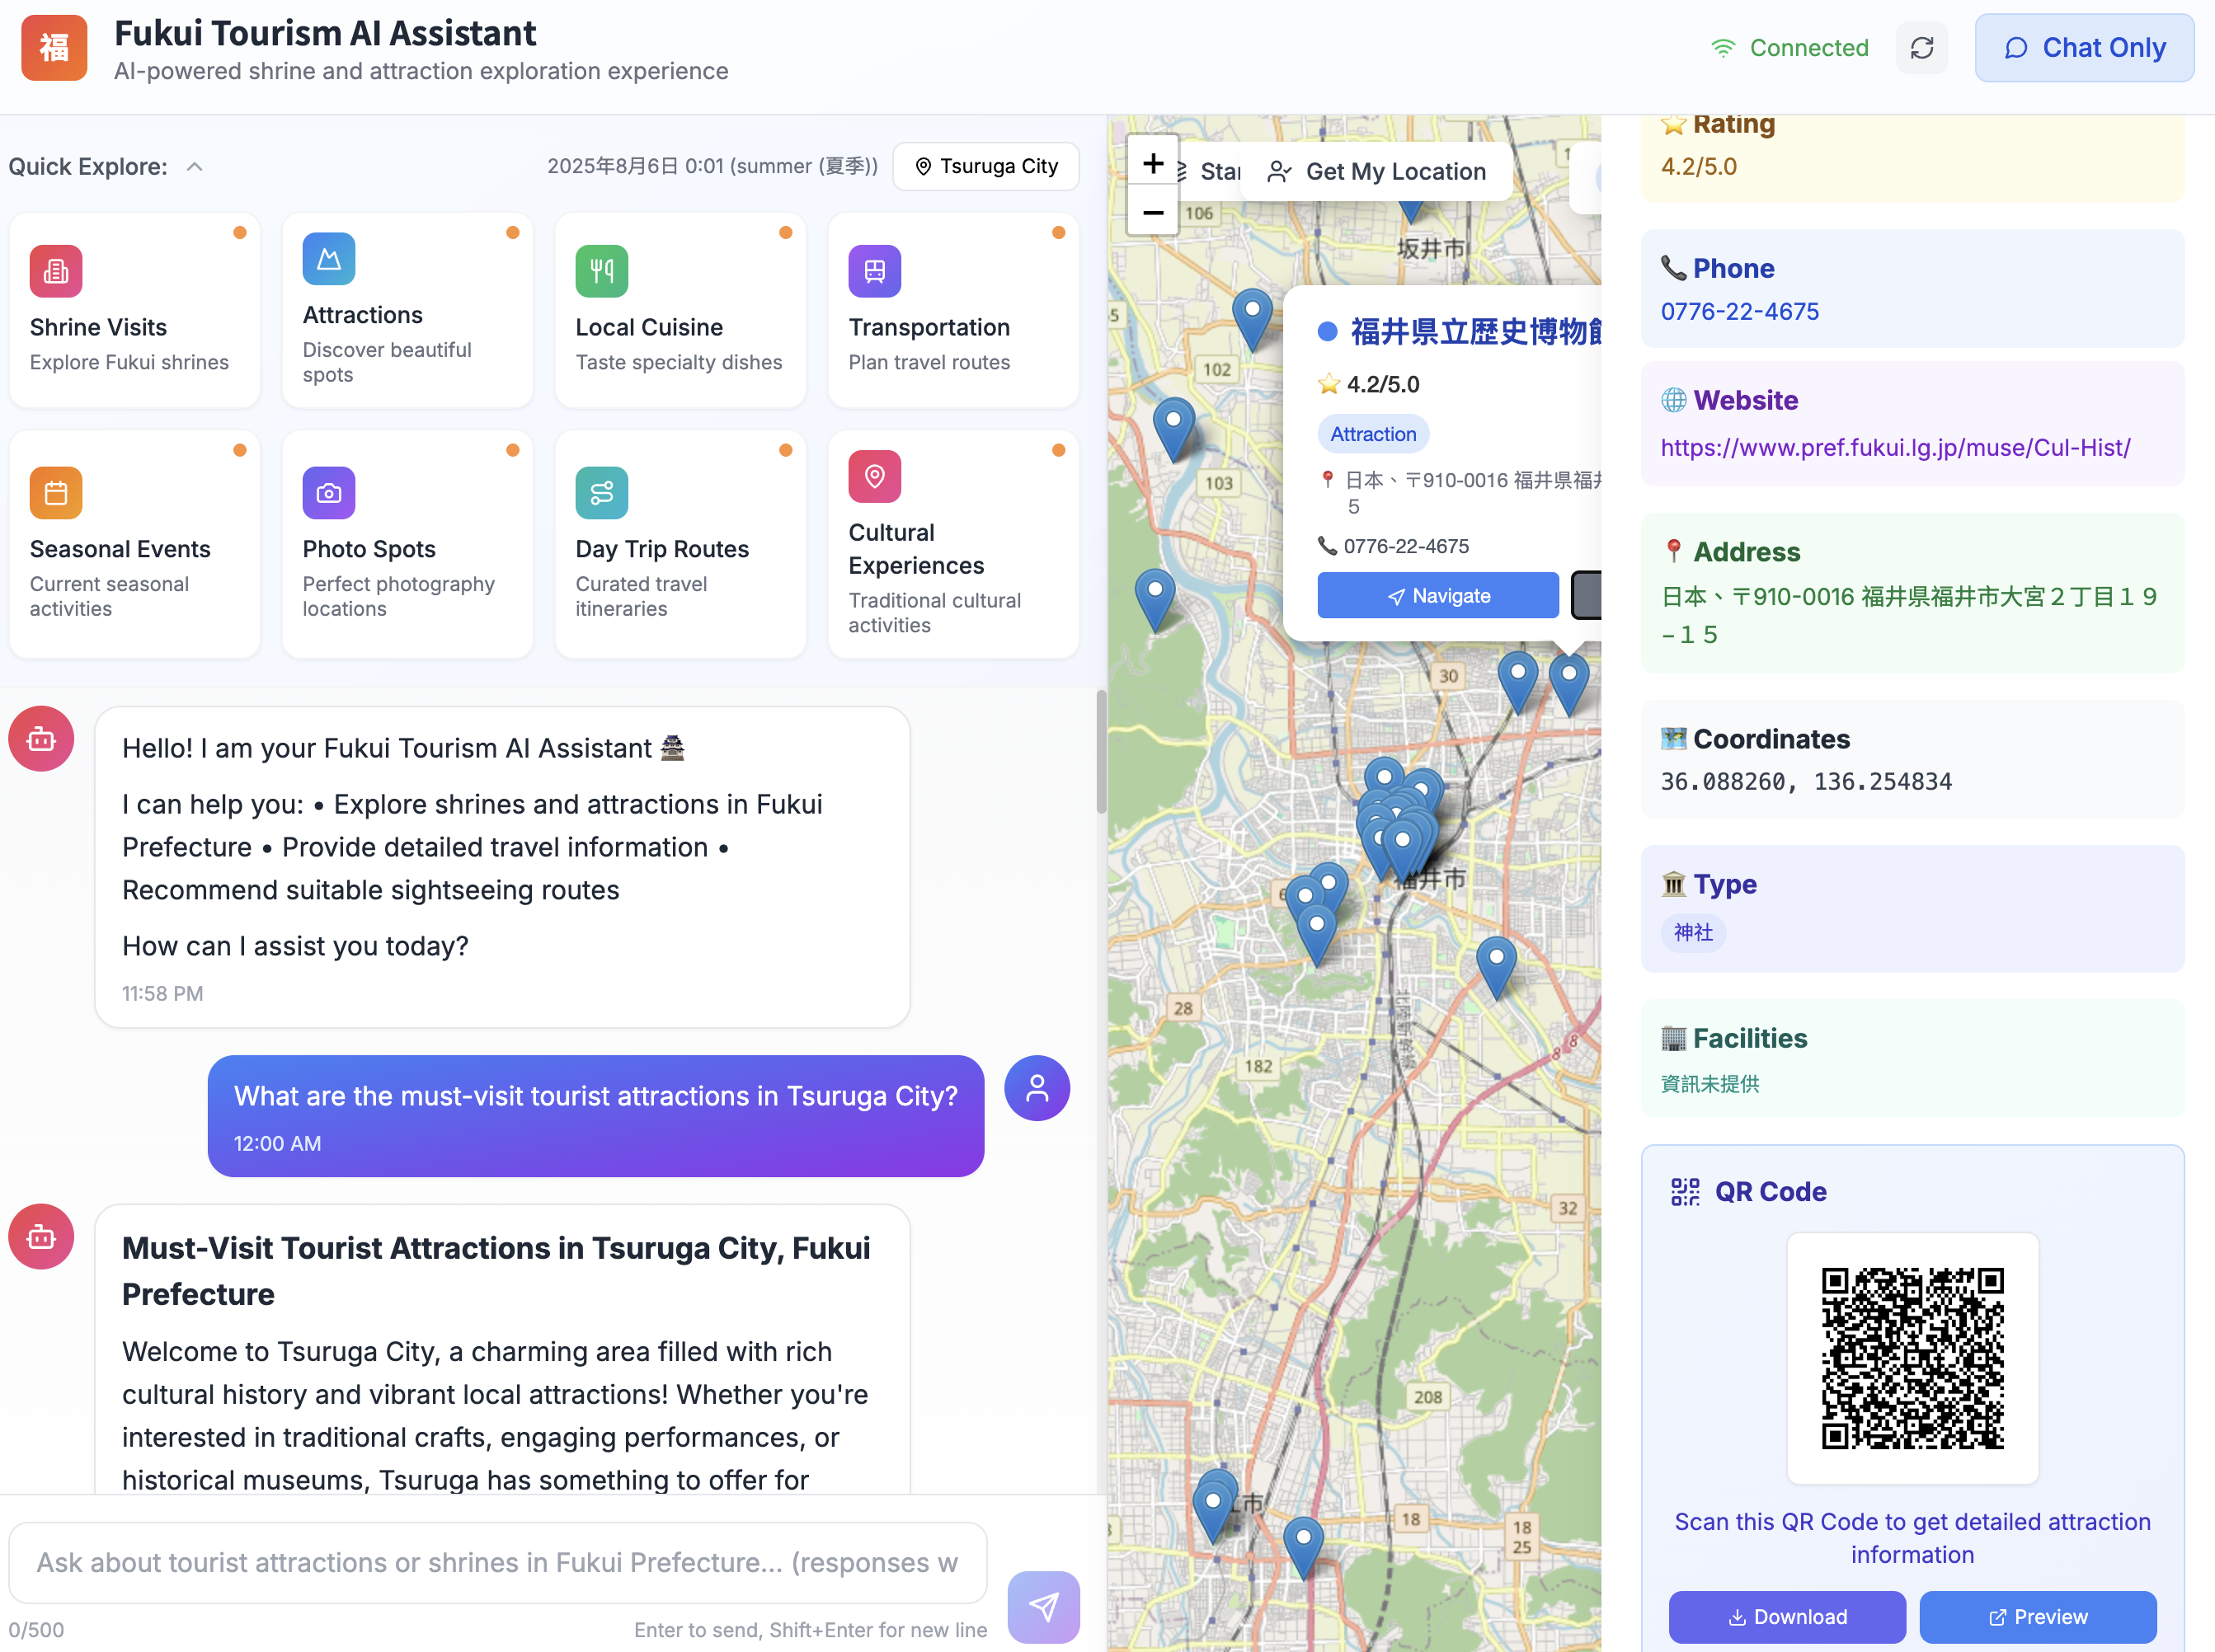
Progress
Chat Mode
Map Mode
Conclusion
Future Work
Formatted the detailed information for all attractions into a structured layout.
User Interface – Map Mode
Formatted & Structured Attraction
Interactive Point-of-Interest Pop-ups
Clicking a location pin on the map instantly displays a summary pop-up and, users can then select "Details" to view more comprehensive information.
Notes:
當使用者點擊『Details』之後，這個詳細的資訊側邊欄就會出現。這裡的一項關鍵更新是，我們將所有資料整理成一個乾淨、標準化的格式。
After a user clicks 'Details,' this detailed information sidebar appears. A key update here is that we've organized all the data into a clean, standardized format.

Slide 14
Progress
Chat Mode
Map Mode
Conclusion
Future Work
Formatted the detailed information for all attractions into a structured layout.
User Interface – Map Mode
Formatted & Structured Attraction
Interactive Point-of-Interest Pop-ups
Clicking a location pin on the map instantly displays a summary pop-up and, users can then select "Details" to view more comprehensive information.
QR Code for Traveler Reviews
By scanning it, users can directly access more traveler reviews and comments for the location.
Notes:
此外，您會注意到我們在這個面板底部增加了一個 QR Code。使用者可以用智慧型手機掃描它，來獲得更詳細的資訊和評論，例如該地點的 Google 地圖頁面。
Additionally, you'll notice we've added a QR code at the bottom of this panel. Users can scan this with their smartphone to get even more detailed information and reviews, such as the location's Google Maps page.

Slide 15
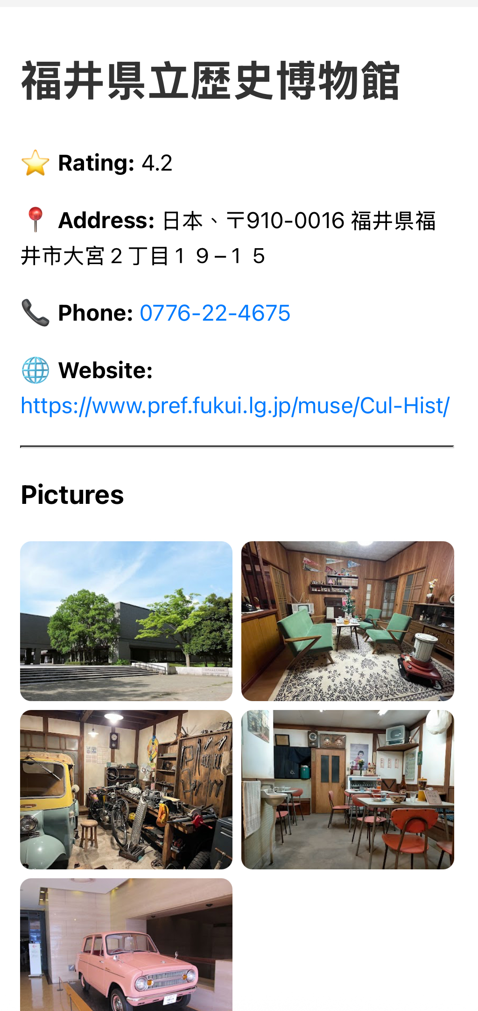
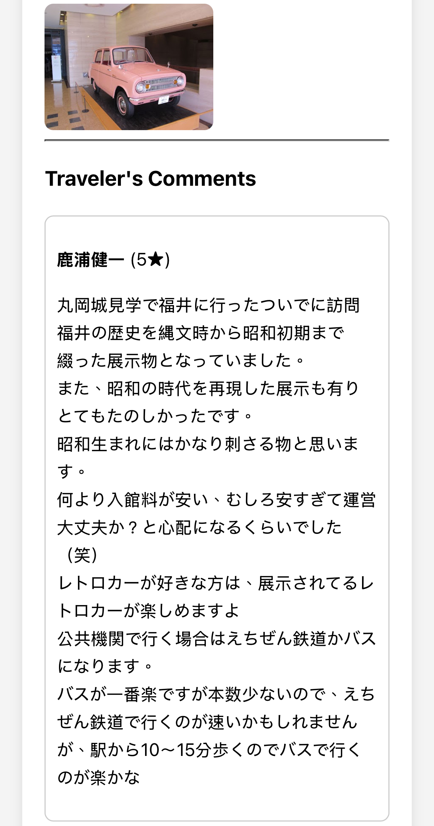
Progress
Chat Mode
Map Mode
Conclusion
Future Work
User Interface – Map Mode
Integrated Attraction Overview Page
By leveraging the Google Maps API, we aggregate detailed information, multiple photos, and traveler comments into a single, comprehensive page to provide users with a complete overview of the location.
Notes:
最後，這是使用者會看到的整合式總覽頁面，例如在掃描 QR Code 之後。我們透過 Google Maps API 將所有相關資料彙整到一個地方。
Finally, this is the comprehensive overview page a user sees, for instance, after scanning the QR code. We use the Google Maps API to pull all relevant data into one place.
這包含了基本資訊、照片集，以及非常重要的——真實的旅客評論。這讓使用者能對景點有一個完整的印象，將事實資料與真實的使用者回饋結合在一起。
This includes essential details, a gallery of pictures, and, importantly, real traveler comments. This gives users a complete picture of the attraction, combining factual data with authentic user feedback.

Slide 16
Progress
Chat Mode
Map Mode
Conclusion
Future Work
This Week‘s Conclusion
This week, we have successfully integrated the Chat and Map modes to create a seamless user journey—from discovery and querying to in-depth exploration. With context-aware AI, smart query generation, and comprehensive data integration, our platform now possesses the core capability to provide personalized and efficient travel planning assistance.
Future Work
Recommendation Optimization
Append new module "Edit Mode"
Notes:
結論是，我們本週最主要的成就，就是無縫整合了聊天與地圖模式。
In conclusion, our main achievement this week is the seamless integration of our Chat and Map modes.
我們打造了一個完整的使用者流程，能帶領旅客從最初的探索，一直到深入的資訊研究。
We've created a complete user flow that takes a traveler from initial discovery to in-depth research.
透過導入像情境感知 AI 和詳細的結構化資訊面板等功能，我們已經為一個人化的旅遊規劃助理，建立了穩固的基礎。
By implementing features like context-aware AI and detailed, structured information panels, we have built a solid foundation for a personalized travel planning assistant.

Slide 17
Progress
Chat Mode
Map Mode
Conclusion
Future Work
Future Work
Recommendation Optimization
To improve recommendation quality, we plan the following optimizations:
For "Photo Spots": Responses will be enhanced to directly output images of locations for a more visual and intuitive experience.
For "Day Trip Routes": We will provide more professional, package-style itineraries inspired by popular travel websites.
Notes:
展望我們未来的工作，第一個目標是優化推薦功能。
Looking ahead at our future work, our first goal is to optimize the recommendation features.
針對『Photo Spots』這個類別，我們希望 AI 的回覆不只是文字，而是附上照片庫，讓建議更視覺化、更吸引人。
For the 'Photo Spots' category, instead of just text, we want the AI to respond with a gallery of photos to make the suggestions more visual and appealing.
至於『Day Trip Routes』，我們計畫提供結構更完整的套裝行程，類似您在成熟的旅遊網站上會看到的那種，給使用者更具體的計畫。
For 'Day Trip Routes,' we plan to provide more structured, package-style itineraries, similar to what you might find on established travel websites, to give users more concrete plans.

Slide 18

Progress
Chat Mode
Map Mode
Conclusion
Future Work
Future Work
Introduction of "Edit Mode"
We plan to introduce an "Edit Mode," granting authorized partners, such as local businesses and government agencies, the ability to add and edit point-of-interest information. This will ensure our map data is flexible, accurate, and always up-to-date.
Notes:
我們計畫開發的另一項關鍵功能是『編輯模式』。
Another key feature we plan to develop is an 'Edit Mode.'
這會是一個給我們合作夥伴，例如在地商家或政府觀光單位，所使用的特殊介面。
This will be a special interface for our partners, like local businesses or government tourism offices.
它將授權他們可以直接新增景點，或更新現有的資訊，像是營業時間或特別活動。這個方法能讓我們的地圖更動態，並確保提供給旅客的資訊永遠是最新且可靠的。
It will empower them to directly add new attractions or update existing information, such as opening hours or special events. This approach will make our map more dynamic and ensure the information is always current and reliable for travelers.

Slide 19

Progress
Chat Mode
Map Mode
Conclusion
Future Work
Future Work
AI-Powered Travelogue Generation
Users can upload their travel photos, and the AI will leverage its rich database of attraction images and text to automatically identify locations and generate a personalized travel journal for their Fukui trip.
Notes:
最後一個未來的目標，我們正在規劃一個 AI 驅動的遊記生成器。
And for our final future goal, we're planning an AI-powered travelogue generator.
因為我們的 AI 已經有針對景點的豐富圖文資料庫，使用者未來將可以上傳他們旅程中自己的照片。
Because our AI has a rich database of text and images for attractions, users will be able to upload their own photos from their trip.
系統會自動辨識他們去過的地方，並幫助他們創建一篇個人化、整理好的旅遊日誌，讓儲存與分享旅行回憶變得更加輕鬆。
The system will then automatically recognize the places they visited and help them create a personalized, well-organized travel journal, making it easy to save and share their memories.

Slide 20
Thank You!
2025/08/08

